Slide 1
Chapter 2 Properties of Matter
Targets
2.1 Classify and distinguish between types of matter.
2.2 Distinguish between physical and chemical properties and changes

Slide 2
Classifying Matter
Pure Substances
Matter that always has the same composition.
What does composition mean?
Elements
Matter that cannot be broken down any simpler and still have its properties

Slide 3
Elements
Are made up of atoms
An element is a pure substance that contains only one type of atom.
Elements are generally represented with a one or two letter symbol.

Slide 4
Compounds
Compounds are substances that are made up of two or more atoms that are chemically attached to each other.
Ex. Water, oxygen, carbon dioxide
Compounds can be chemically broken down into a simpler form but they will not have the same set of properties.

Slide 5
Chemical vs physical
Chemically breaking down a substance refers to breaking apart bonds.
Physically breaking down a substance does not break chemical bonds it just breaks it into smaller pieces.

Slide 6
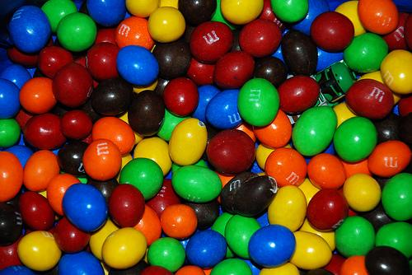
Mixtures
Mixtures are multiple compounds “mixed” together.
You can separate a mixture by physical means.

Slide 7
Types of Mixtures
Heterogeneous vs. Homogeneous

Slide 8
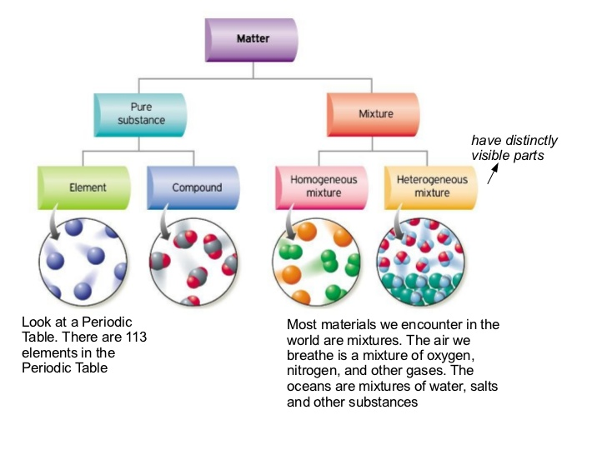

Slide 9
Solutions
When you can dissolve one substance into another it is called a solution.
Solvent- the liquid you are trying to dissolve into.
Solute-what you want dissolved.
Generally they form a homogenous mixture.

Slide 10
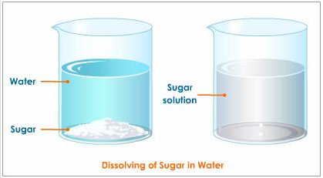
Examples of solution
Sugar water

Slide 11
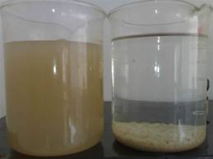
Suspension
This is a mixture where the solute will mix in if given enough energy but once the energy is gone it will settle out.
Starch and water
Sand in water

Slide 12
Colloids
Are in between suspension and solutions
They may have some particles that will stay mixed in the solvent but other that will fall out once the energy is gone.

Slide 14
